Slide 1
JAGKY
Summer Training

Slide 2
Making the Pitch
DRIP DROP
https://www.youtube.com/watch?v=y5nmwuu6RX0

Slide 3
Meet today’s “JAG SHARKS”
Audra Patrick: The HSN Queen! Audra is the creator of over 100 products that have been sold on HSN and she has a became a self-made Millionaire overnight! She knows instantly if a product is a “ hero or a zero”
Ryan Adams: Ryan is the designer and CFO of his own Men’s clothing line designed for the everyday “Southern Gentleman.” He turned his home based clothing line into a brand being sold in over 300 stores nationwide.
James Bruce: Former NBA star turned Real Estate Icon. James not only enjoys investing in companies which he believes in but he also tours the country as a motivational speaker and book author.

Slide 4
Directions
Each team will have 15 minutes to come up with an imaginary product and develop a pitch for it.
Use the included paper and markers on each table to create a visual for the “Sharks.” Also, please feel free to add any additional demonstrations that you feel may better “sell” your product!
Each team will select two members who will have two minutes to present their “pitch” to the sharks.
Sharks are allowed to ask additional questions as well if time allows.
After each team has had their turn, the “Sharks” will come to a mutual decision of who they will invest their money with!!!

Slide 5
Here we go!
This pitch must be professional and include:
Drawing of Product
Brand name
Brand slogan (Ex. Just do it,)
Marketing plan ( Ex. Internet Ads, TV Commercials)

Slide 6
Connections to JAG Competencies:
C17-Demonstrate Time management
C18- Follow Directions
D24- Communicate Verbally
E26-Demonstrate Team Membership
E27- Demonstrate Team Leadership
E28- Deliver Presentations to a Group
E29-Compete Successfully with Peers

Slide 7
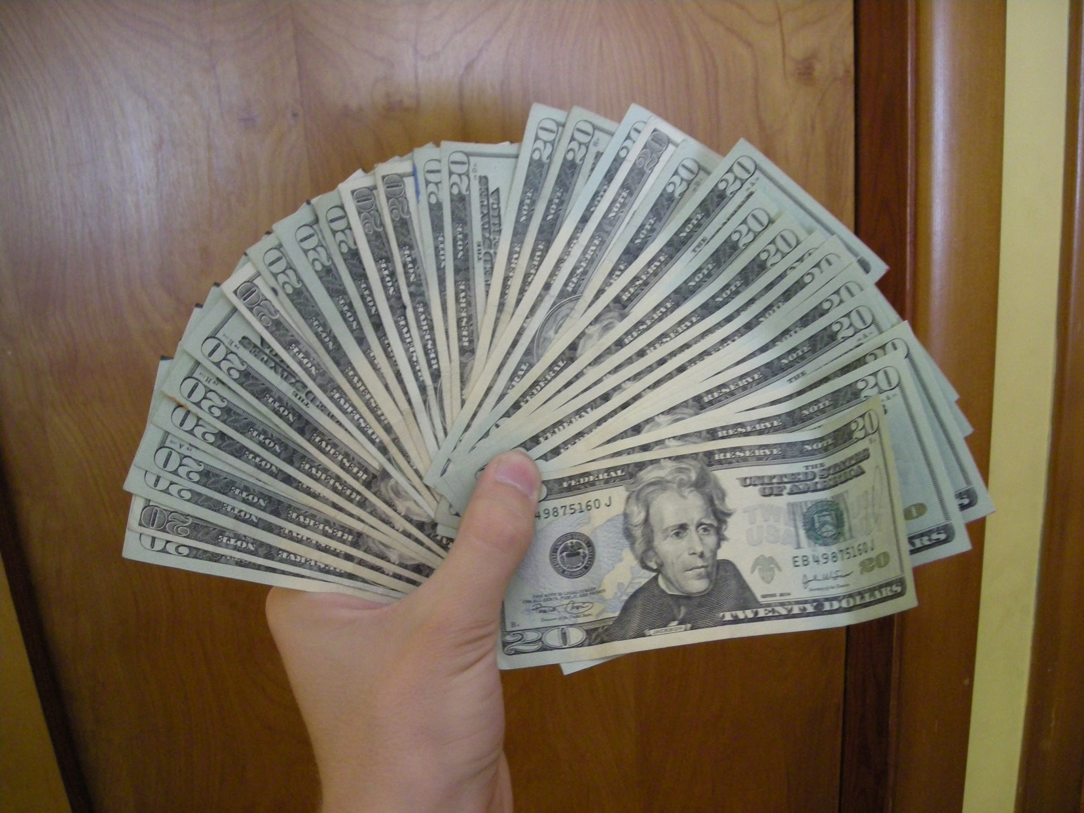
JAG Competencies Continued:
F36-Demonstrate a Positive Attitude
G49-Provide Constructive Feedback
H62- Demonstrate how to work effectively with Others

